Slide 1
Web testing with Selenium
UA/DETI/TQS
Ilídio Oliveira (ico@ua.pt)
v2019-02-26.

Slide 2
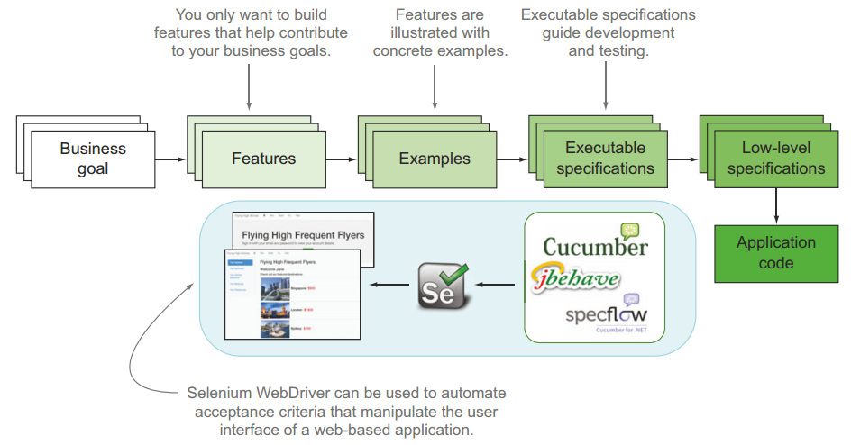

Slide 3
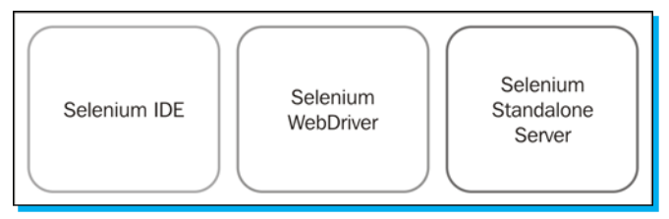
Selenium framework

Slide 4
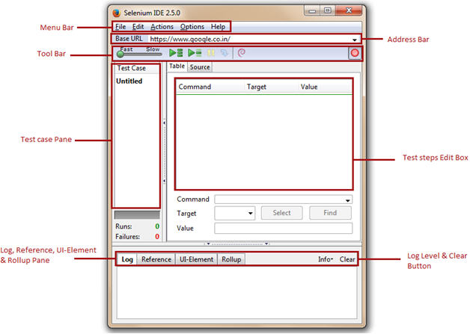
Selenium IDE (deprecated)
http://docs.seleniumhq.org/projects/ide/

Slide 5
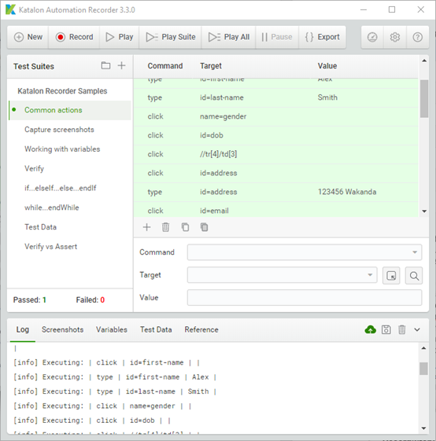
Katalon Automation Recorders (browser add-on)

Slide 6
Command | Description
open | Opens a specified URL in the browser.
assertTitle, VerifyTitle | Returns the current page title and compares it with the specified title
assertElementPresent, verifyElementPresent | Verify / Asserts the presence of an element on a web page.
assertTextPresent, verifyTextPresent | Verify / Asserts the presence of a text within the web page.
type, typeKeys, sendKeys | Enters a value (String) in the specified web element.
click, clickAt, clickAndWait | Clicks on a specified web element within a web page.
waitForPageToLoad | Sleeps the execution and waits until the page is loaded completely.
waitForElement Present | Sleeps the execution and waits until the specified element is present
chooseOkOnNextConfirmation, chooseCancelOnNextConfirmation | Click on ”OK” or “Cancel” button when next confirmation box appears.

Slide 7
Selenium framework

Slide 8
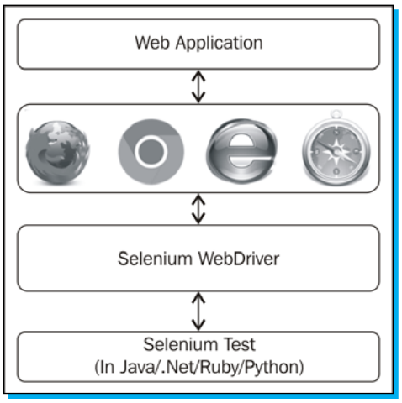
Selenium WebDriver

Slide 9
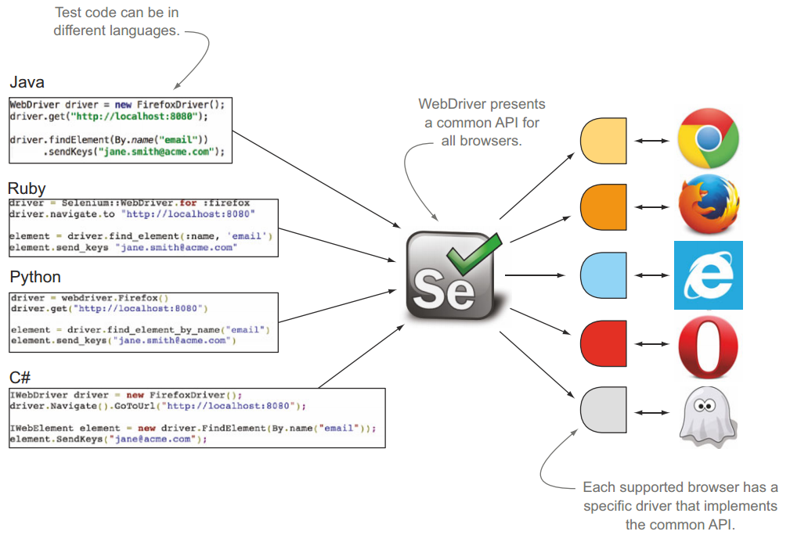

Slide 10
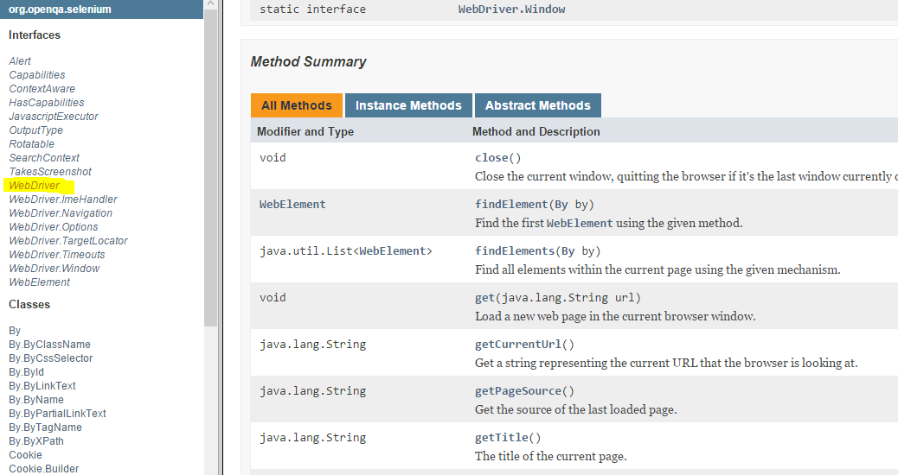
https://seleniumhq.github.io/selenium/docs/api/java/org/openqa/selenium/WebDriver.html

Slide 11
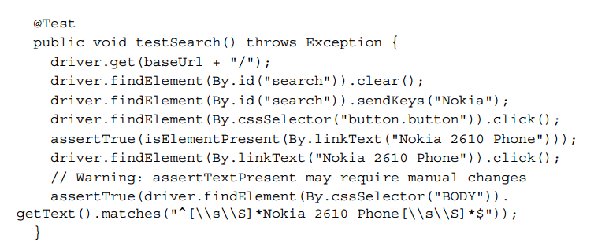

Slide 12
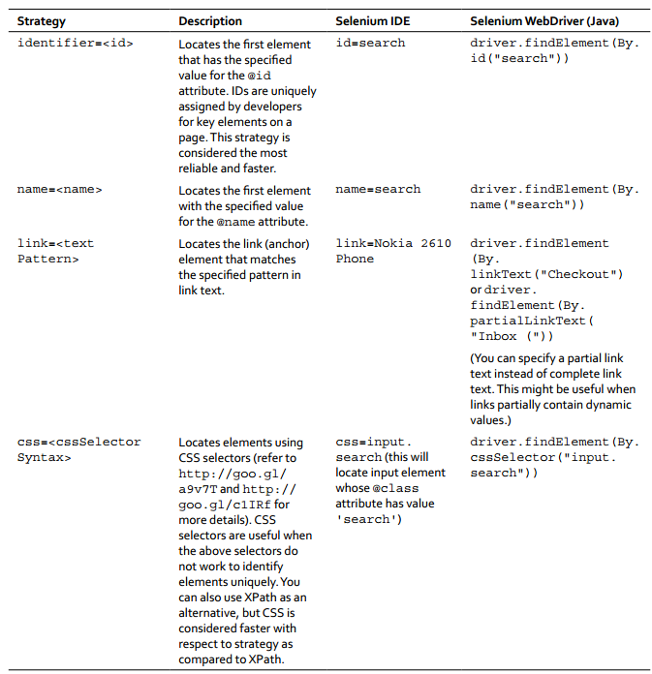

Slide 13
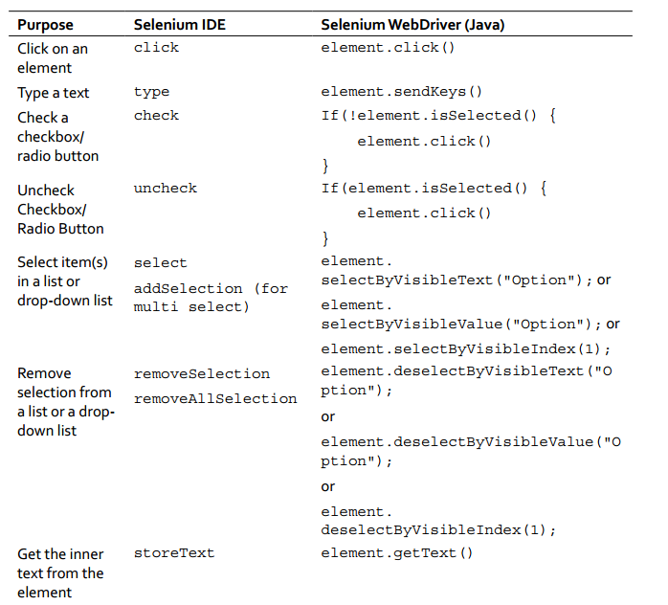

Slide 14
Suggested links
Book: “Instant Selenium Testing Tools Starter”
Selenium + Cucumber sample
Comprehensive tutorial

Slide 15
Hands-on
http://www.thinkcode.se/blog/2012/10/29/selenium-webdriver-the-simplest-possible-start
http://www.thinkcode.se/blog/2011/10/18/testing-a-web-application-with-selenium-2

